Slide 1

One Team
One Dream
Girls Spring 2025
Legacy High School

Slide 2
2025 Girls Soccer Coaches
Head Coach/Assistant
Mick Lenhardt/Grant Heidrich
Varsity Reserve
Logan Reuschlein
Goalie Coach
      Brooke Binegar
JV 2 Coach
Sage Talmadge

Slide 3
Legacy Teams
Varsity: Every WDA team twice. No WDA tournament. Top 4 teams go to state
Junior Varsity: Same schedule as varsity. No end of season tournament.
JV2: Schedule will be set depending on number of girls/teams in region.
Schedule is obviously weather dependent. Follow Rschool for the most updated schedule.

Slide 4
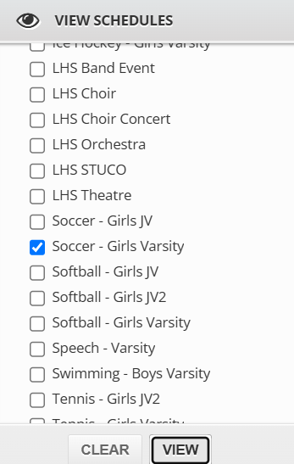
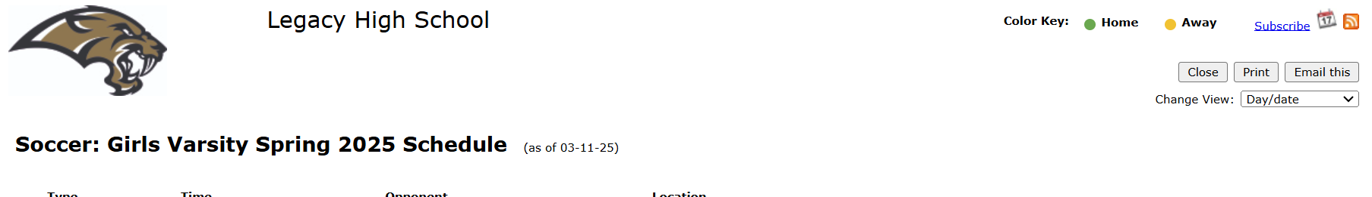
Legacy Teams
Subscribing to a schedule on your phone will give you updated schedule changes

Slide 5

Coaches Responsibilities
Put athletes in position to succeed at whatever level they are at
Help players develop at their level. Not everyone has the same floor or ceiling, but everyone can improve
Create program of accountability, honesty, and respect
Create a safe and fun environment for all players on all teams
Open and honest communication with players
See handbook for more details

Slide 6

Completed Before First Practice
Physicals – physical form MUST be completed prior to the first practice. Athletes should go to the doctor as they normally do to get their physical. Upload the form to Rschool
Registration must be completed on Rschool including activity fee ($50) paid on MyPaymentsPlus

Slide 7

BPS/NDHSAA Policies
All fees, physicals, forms, and impact testing must be completed before the first match.
Students must be in school for the full day the day of a match! This includes doctor appointments/dentist appointments/any non-BPS absence.
All NDHSSA rules on drugs, alcohol, and tobacco are in effect. Possession or use will result in suspension. “Mere Presence” includes Snapchat/Instagram/TikTok, and/or other internet sites with pictures is part of the rule. (6 week suspension)

Slide 8

Impact Testing/Athletic Trainer
Jordan Davis is our Head Trainer at Legacy.
Sway Medical app is used for baseline concussion testing.
ALL athletes who have not participated in a sport at Legacy this school year.

Slide 9

Important Information
First 3 practices will be used to evaluate players for team placement
Mandatory 9 practices before a player may play in a game.
Mon 24th: 5:30 Outside
Tues 25th: 5:30
Wed: 26th: 5pm POWER HOUR Kick Off Before practice!
Thur 27th: 5:30pm
Fri 28th: Pictures. 6pm Johnson Gym
Sat 29th: Time TBD
Monday: March 31st: Time TBD
****Dickinson Match Scheduled for May 22nd*** (last day of finals)
**Away match at Williston might change**

Slide 10

Practice Expectations
Attend practice regularly.
Be ready to begin practice on time. (dressed and ready to begin)
Contact coach before practice if practice time will be missed. Use SportsYou or call/text.
Clean up equipment after practice. Not captain role, not freshmen role, it is everyone’s role. Lead by example.
Work hard at improving during practice, but still have fun

Slide 11

Game Responsibilities
Be mentally and physically ready to play. Get the right sleep, eat healthy, be “in” the game.
Bring your own water bottle. When its cold there are not always coolers available for water depending on location
Be at the field at least 1 hour before Varsity, Varsity Reserve & 45 mins before JV2 game times.
Dress for the weather. No zippers or buttons on sweatpants. Hoods tucked inside of jersey during games.
No jewelry of any kind, including nose piercings. (Point of enforcement for referees)
Clean up bench after game. Student managers and coaches are not here to pick up after you.
Clean up bus after road trips. Bus driver is not here to clean up after you.

Slide 12
Game Responsibilities
Wear proper game uniform to each game.
Bring shin guards and shoes to games.
Home is dark, away is white.
Varsity/Varsity Reserve purchase both white & black socks, JV2 black socks only.
When it is cold, players may wear Under Armor type clothing, long sleeves shirts, sliding shorts etc. Must match the team, black (home) white (away)

Slide 13
Game Responsibilities
Excel in whatever role you have on gameday. (Starter, sub, bench)
Have the energy and maturity to be great in your role
If your happiness is based on playing time and not the love of your teammates and the sport, this might not be the activity for you.

Slide 14
Player’s Responsibilities
Academics in school and behaviors in the classroom
All players will participate in community service.
Coaches will work with the players to set up these opportunities.
All players, regardless of team/playing time, are equal members of the program and will be treated with respect and will treat others with respect
Players will refrain from putting anything on social media that is detrimental to themselves, the team or Legacy High School.

Slide 15
Process for Addressing Concerns
All concerns should first be addressed by the player with the coach
If the parent needs to address a concern their daughter must be present
Playing time is the coach's decision and is based on player performance in practice and games, it may not be discussed with the coach by the parent alone.
See handbook for more details

Slide 16

Parent Expectations
Parents will positively support their daughter
Parents will refrain from using social media to disparage the program, players, or other programs
Parents will cheer appropriately at all matches and not disrespect other Legacy players, opponents, or the refs.
Parents will support the Boosters and participate in booster club fundraising and events

Slide 17
Off Season Expectations
Players are encouraged to participate in fall and winter sports
If not, players are expected to attend open gyms, open fields, Sanford Power, summer strength and conditioning, or any other activities offered by Legacy
If you aren’t where you want to be, there is more work to do. Not extra. More.

Slide 18
Team Communication
The Legacy Girls Soccer Website
Facebook/IG
Fastest and most up to the moment information
Legacy Girls Soccer has a Twitter account a TikTok account.
Practice Schedules
Game Schedules
Tournaments schedules
http://lhssabersoccer.net/girls/
https://www.instagram.com/legacysabersoccer/
https://twitter.com/LHSsabers
https://www.facebook.com/lhssabersgirlsssoccer

Slide 19
Practice Times & Fields
First Day of Practice is March 24th@ 5:30pm
Normally practice will be on Legacy turf field
Due to field availability practice times may vary
Mon, Tue, Wed, Thu & Fri (some Saturdays)
Once teams are set practice times and locations will be posted weekly.

Slide 20
First Games
First Varsity games April 4th vs Century At SSC (Legacy) 6:00pm JV, 8:00pm Varsity
First JV2 game not yet set

Slide 21

Game Streaming
Streaming will be on HUDL TV (Team1Sports App on phone or smart TV)
https://fan.hudl.com/usa/nd/bismarck/organization/29783/legacy-high-school
Williston streams on NFHS (need account)
Jamestown streams on YouTube
Minot occasionally on PSP
Mandan/Dickinson do not stream
at this time.
St. Mary’s streams on YouTube

Slide 22
Game Fields
The Community Bowl
Sanford Sports Complex (SSC at Legacy)
Cottonwood Park (No fee)-Enter by the third parking lot entrance
Mandan: Starion Sports Complex
Jamestown: Rotary Fields by the High School (back up location turf field on U of Jamestown campus)
Minot: Duane Carlson Stadium
Williston: Williston High School
St. Mary’s: St. Mary’s High School
Dickinson: Sanford Sports Complex (South of HS across the street)
Minot North: Minot North HS

Slide 23

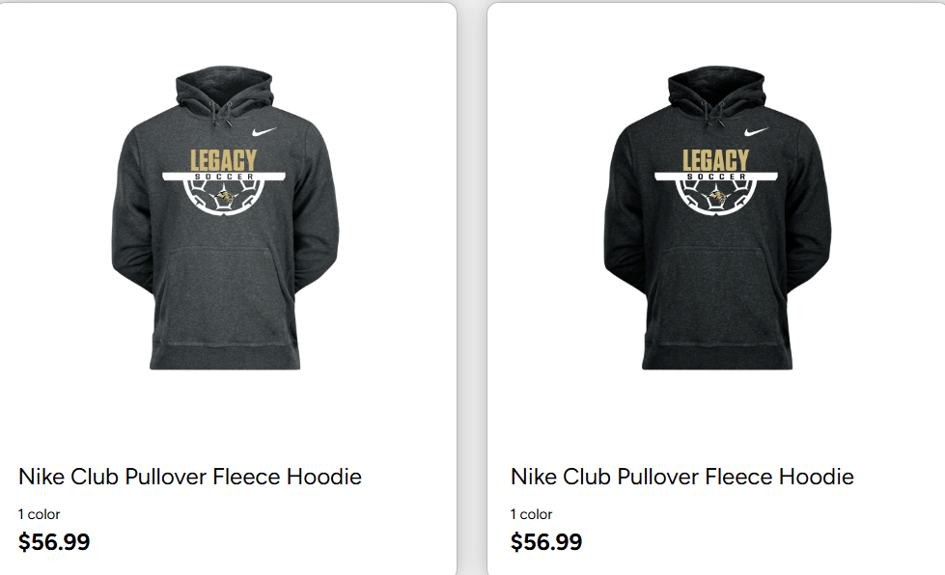
TEAM STORE
https://bsnteamsports.com/shop/LHSGSOC2ND

Slide 24
2025 Girls Boosters
President: Krista Burman
Vice-President: Jen Healy
Treasurer: Sondra Oster
Secretary: Dana Mees
Senior Rep: Lacey Brendel
Junior Rep: Mike Benz
Sophomore Rep: Jamie Ressler
Freshmen Rep: Mindy Hildemyr

Slide 25

Role of the Boosters
The purpose of the Legacy Girls Soccer Booster Club is to serve as a supporting organization for the Legacy High School Girls Soccer athletic program.
Promote and publicize our soccer program
Encourage good sportsmanship and develop team unity
Develop and enhance a sense of pride and tradition
Support the needs of the coaching staff
Provide necessary resources to supplement the financial requirements of the program

Slide 26
What Boosters Provide
Backpacks that girls get to keep
Game day shirts for all players
Sanford Power Training for all girls
Long-sleeve varsity uniforms
Military and Pink Night uniforms!
Winter Coats (next year hope to buy more)/kit deposit
Black and white undershirts for players
Food for trips
Photographer for game photos/senior photos
Hudl for teams to film games
Training equipment for all teams
Game day program
Special Nights: Teacher, Military, Pink, Senior
Senior gifts
End of year banquet
Rental of indoor soccer fields for training/try outs

Slide 27
Booster Fundraising
Calendar Raffle: All girls will be expected to participate in team “blitz” to sell tickets (Thursday the 28th)
Concessions during volleyball/basketball season: Need better parent/student support and participation.
Sponsorships
Booster Fees

Slide 28
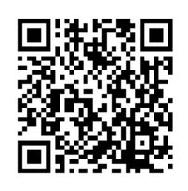
Booster Communication
Boosters use SportsYou app for easier communication. Scan QR code to join.

